Slide 1
Project Report
Big Mountain Resort

Slide 2
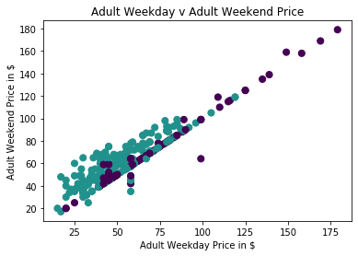
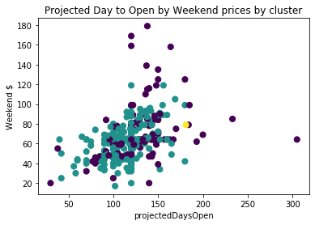
Recommendations
Prices for Adult Weekend tickets to be revised to $89.2 which is 10.2% increase
Likewise, since the prices for tickets in weekdays and weekends are highly correlated hence the prices for Adult tickets on weekdays should also be increased by 10.2%
The projected number of days when the resort should be open to be increased to 143days which will result in 20% increase of people visiting.

